Slide 2
Handheld Updates
Since the previous update:
Determined parts such as valves, pumps, displays, heat sinks, batteries
Determined appropriate procedure for testing
Designed several different methods of sensor exposure to baseline and test environments
Considering placing a naked MOS on the outside of the device to act as an ambient VOC Sensor, accompanied with an LED to alert the presence of it

Slide 3
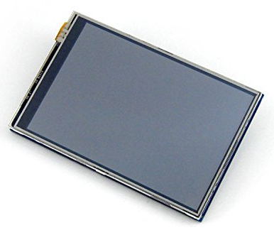
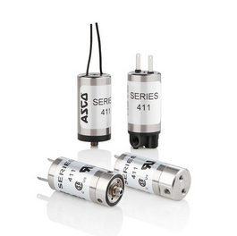
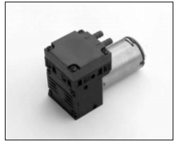

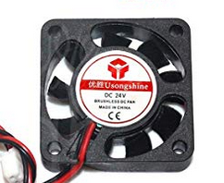
Selected Parts
ASCO 411M2305HV solenoid valve
KNF NMP 830 KNDC
Waveshare 3.5” TFT Raspberry Pi Display

Slide 4
Testing Process
Both chambers are flushed with baseline air
Sensor is moved to the baseline chamber
Baseline chamber is filled with baseline air
Testing chamber is filled with external air
Sensor is exposed to baseline air
Sensor is moved to testing chamber
Sensor is exposed to testing air
Both chambers are flushed with baseline air

